Slide 1
Hotel Rating

Slide 2
Group Members
Deeksha Singh
Tushar Machhindra Kalaskar
Prashant Anil Kumbhar
Akhila
Litun Ghadai
Pratiksha Dhamale

Slide 3
Business Objective
This is a sample dataset which consists of 20,000reviews and ratings for different hotels and our goal is to examine how travelers are communicating their positive and negative experiences in online platforms for staying in a specific hotel and major objective is what are the attributes that travelers are considering while selecting a hotel. With this manager can understand which elements of their hotel influence more in forming a positive review or improves hotel brand image.

Slide 4
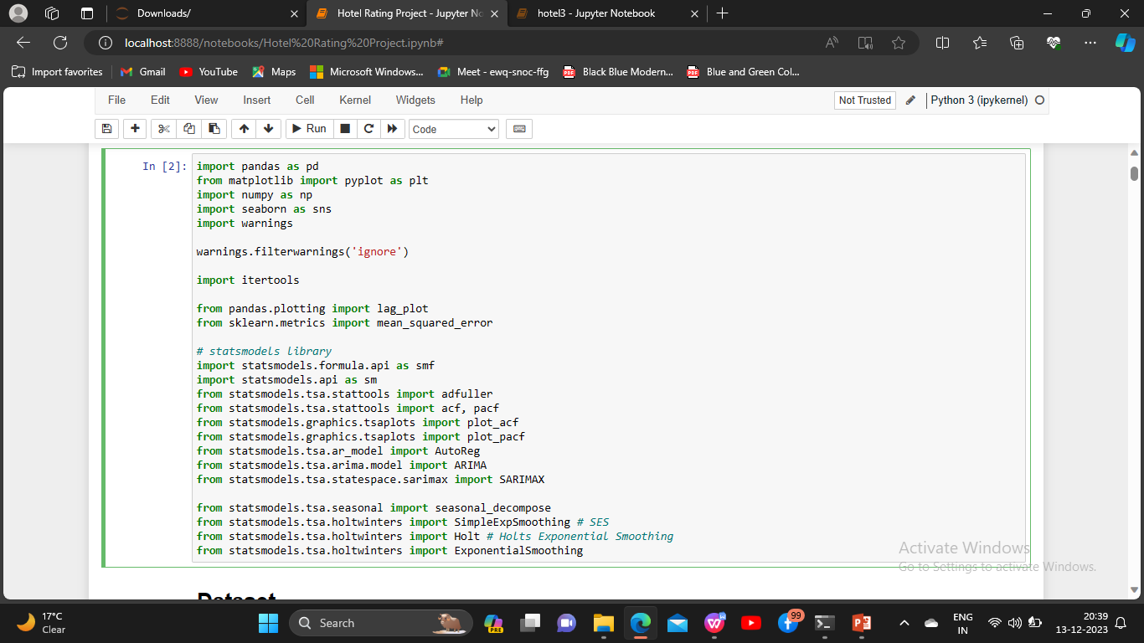
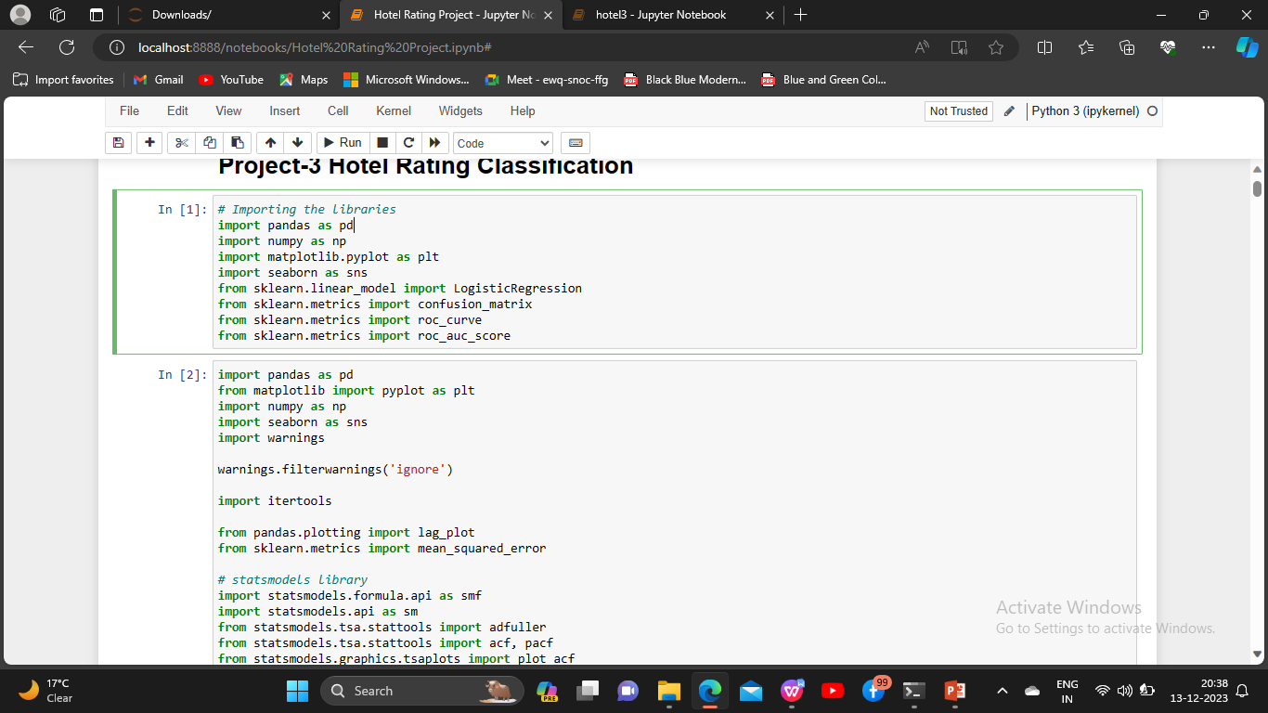
Imported libraries

Slide 5
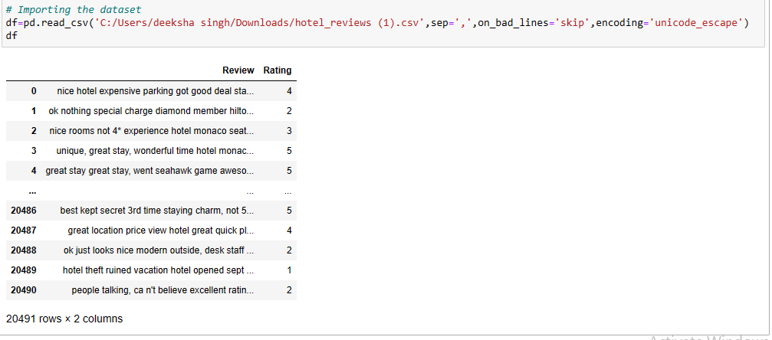
Dataset

Slide 6
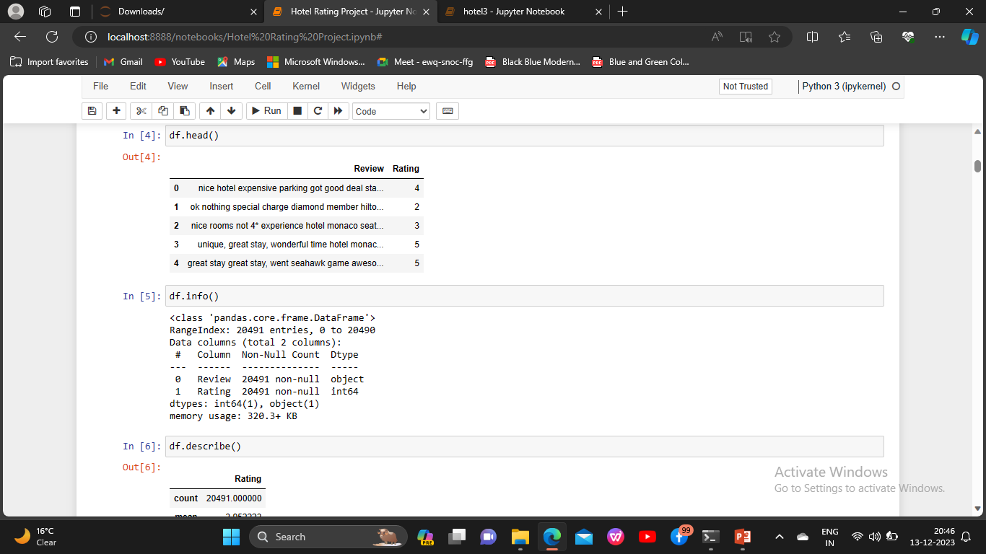
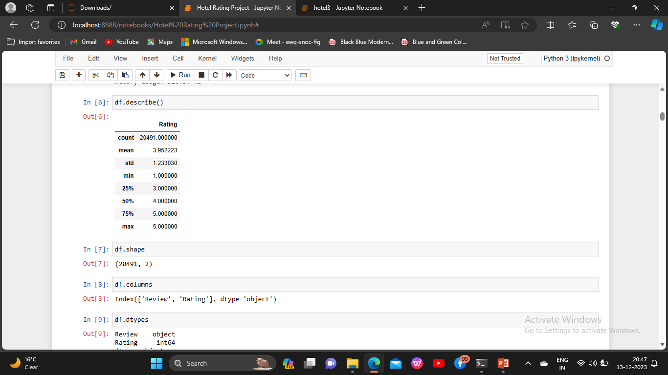
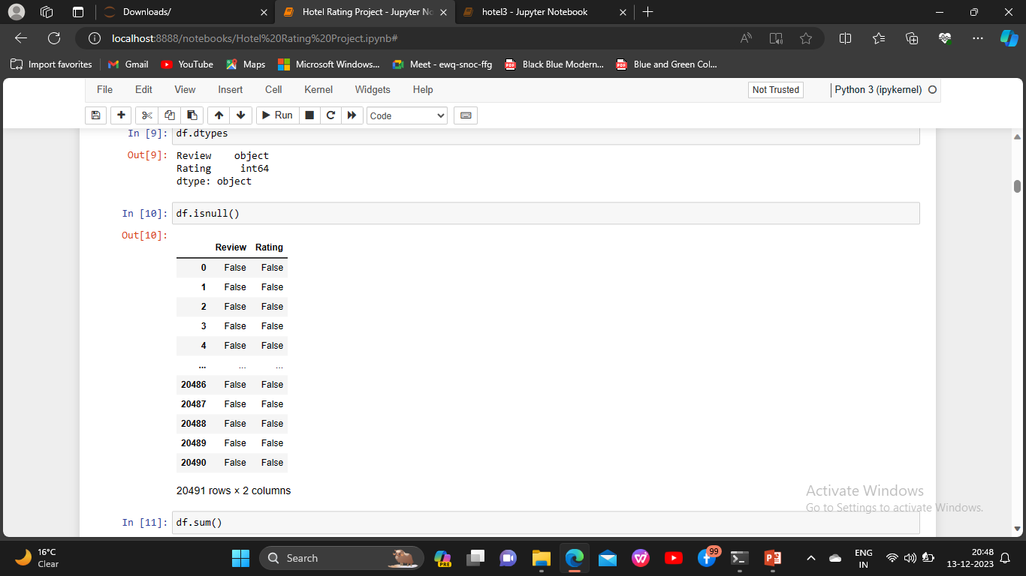
EDA(Exploratory Data Analysis)

Slide 7
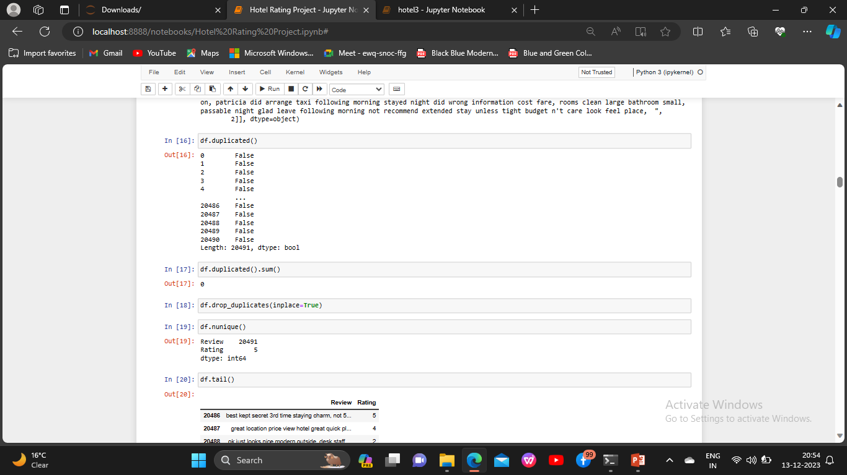
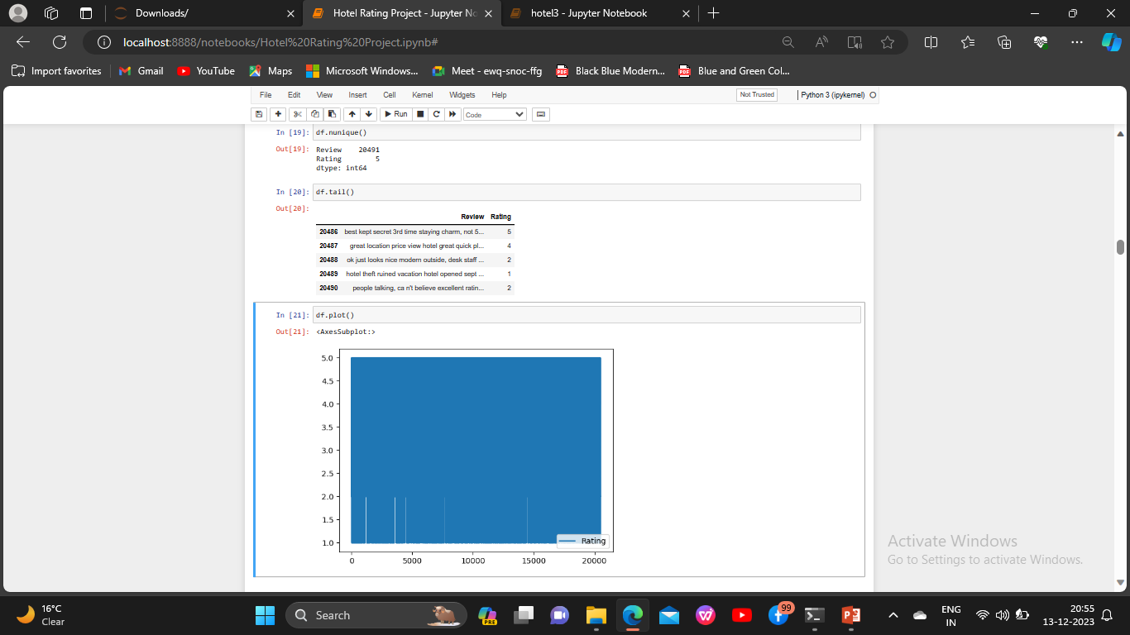
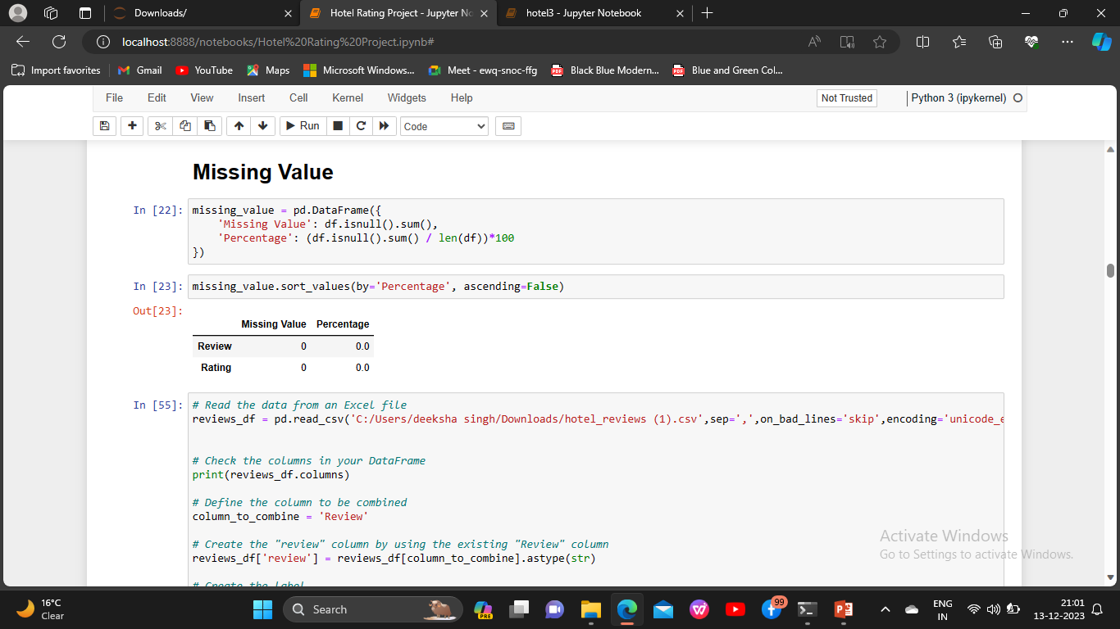
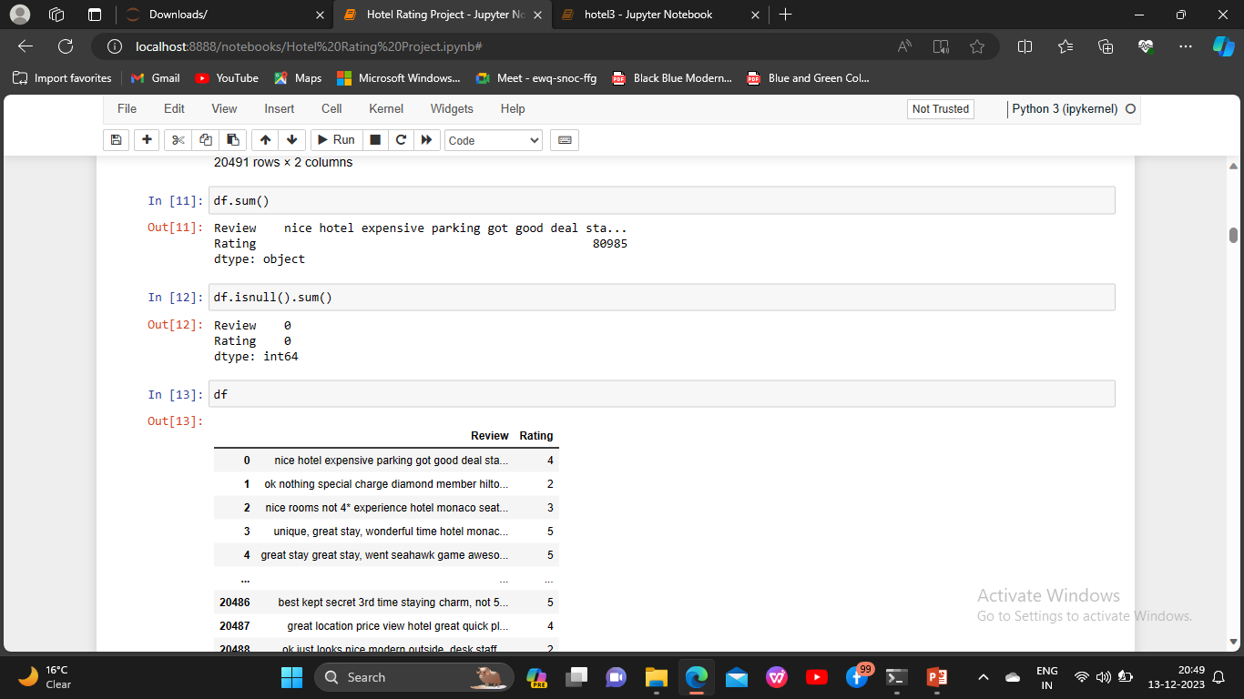

Slide 8
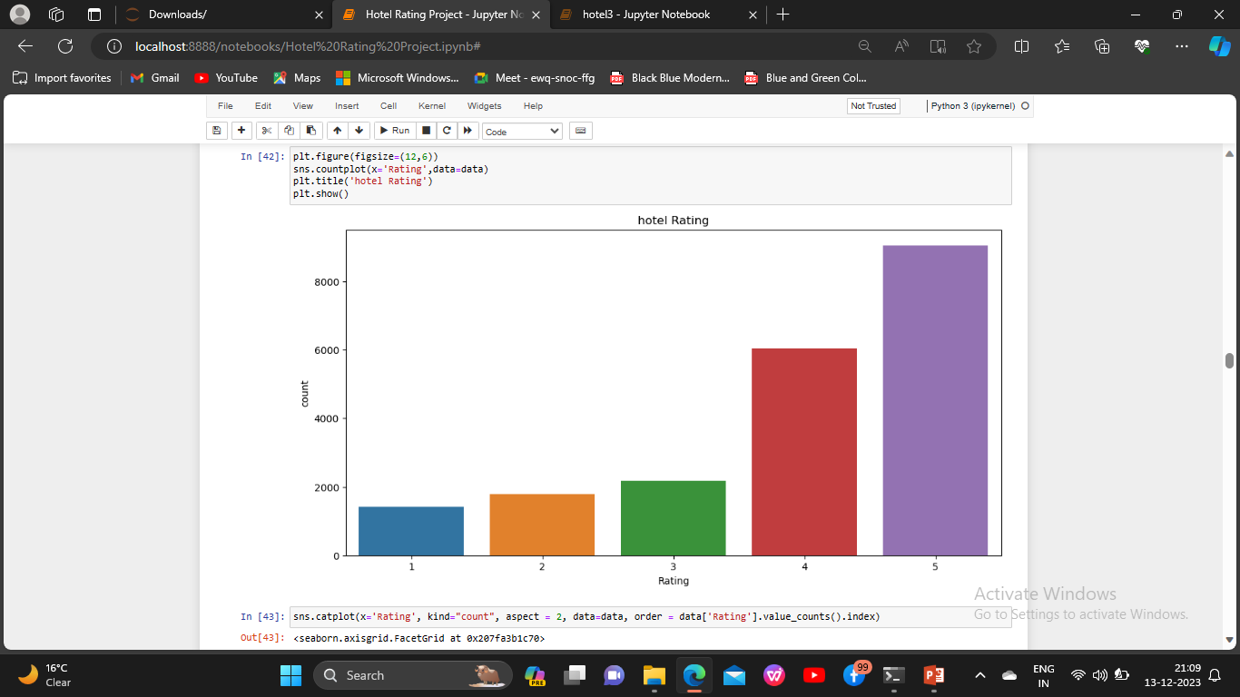
Visualizations Hotel Rating

Slide 9
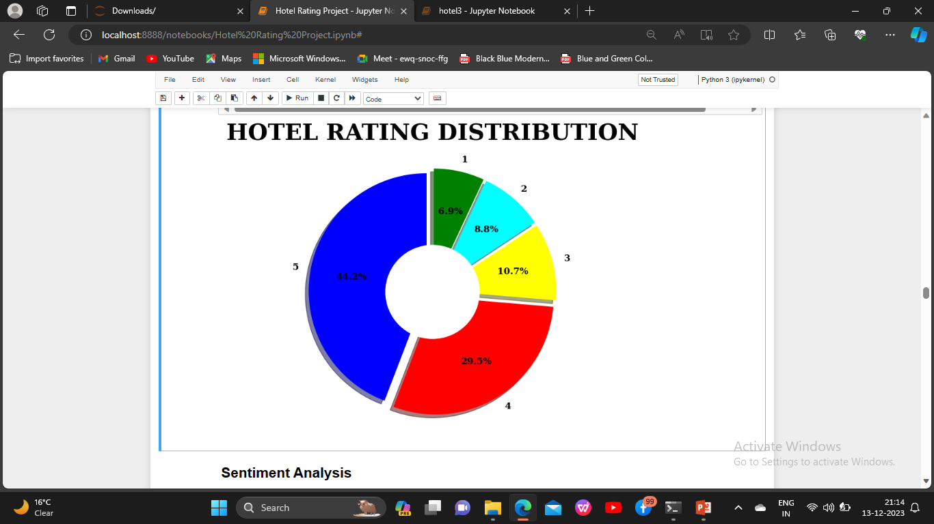
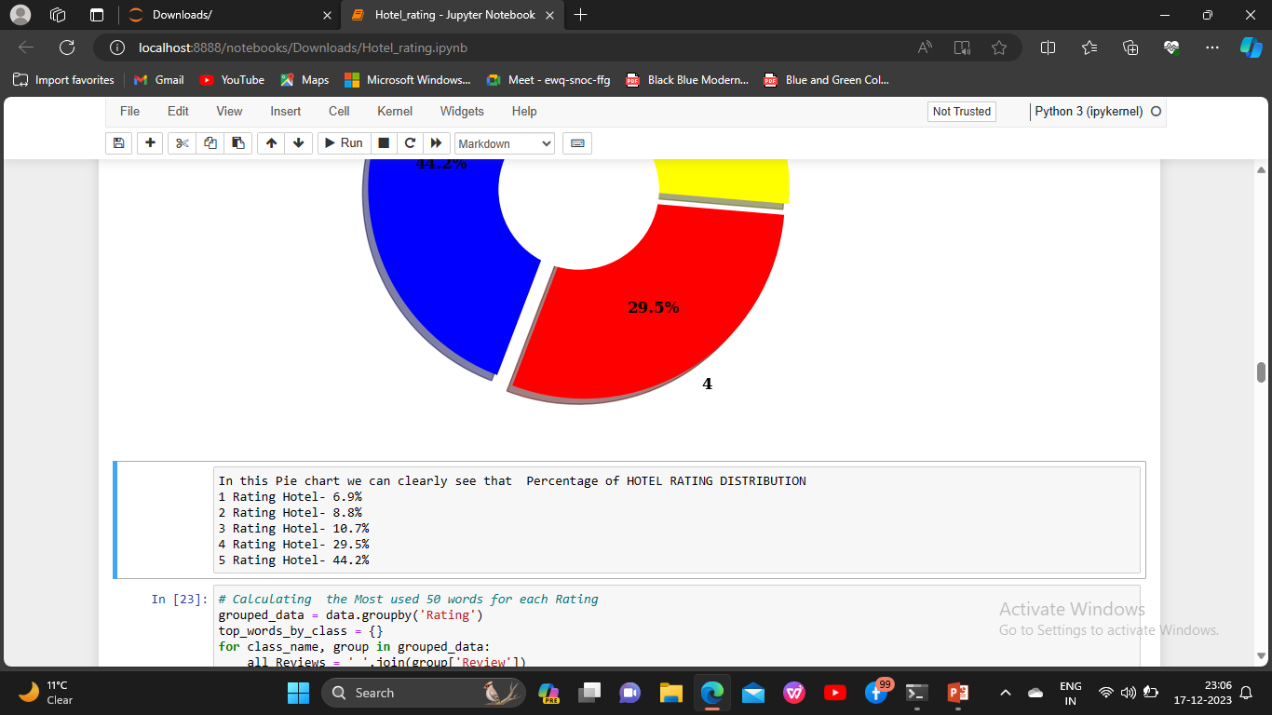

Slide 10
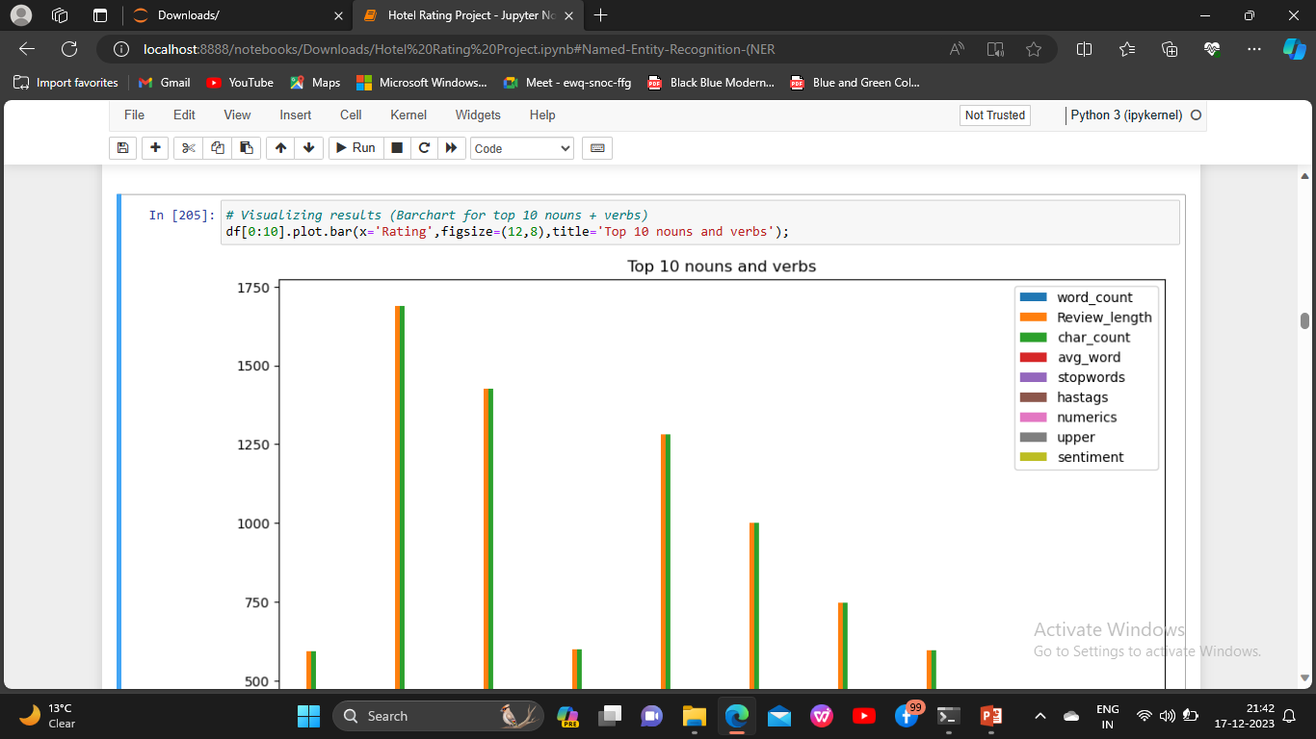
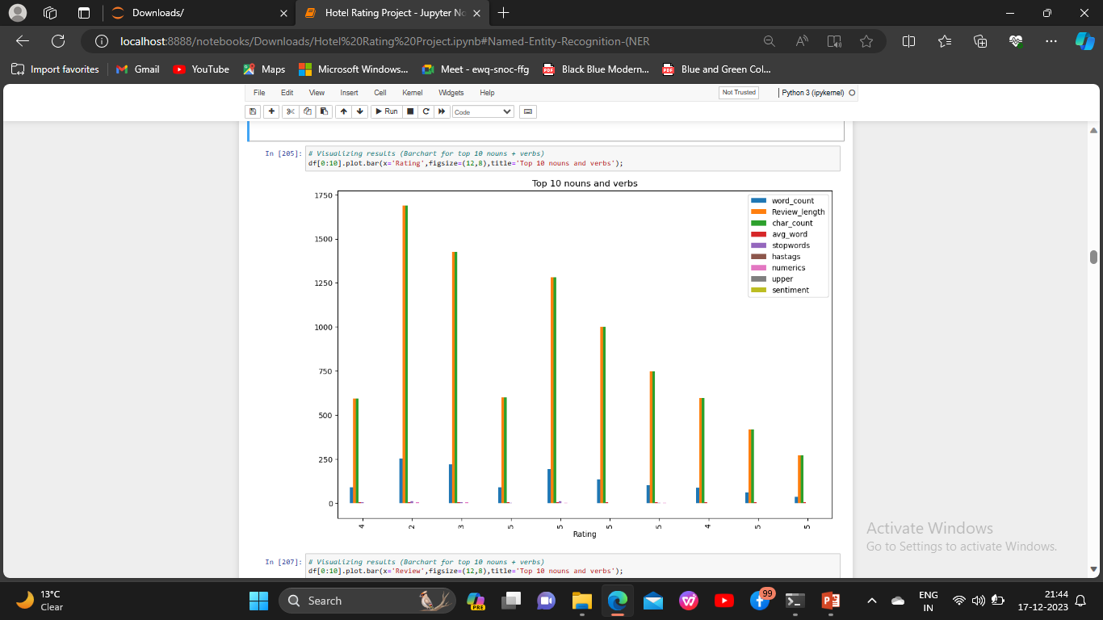

Slide 11
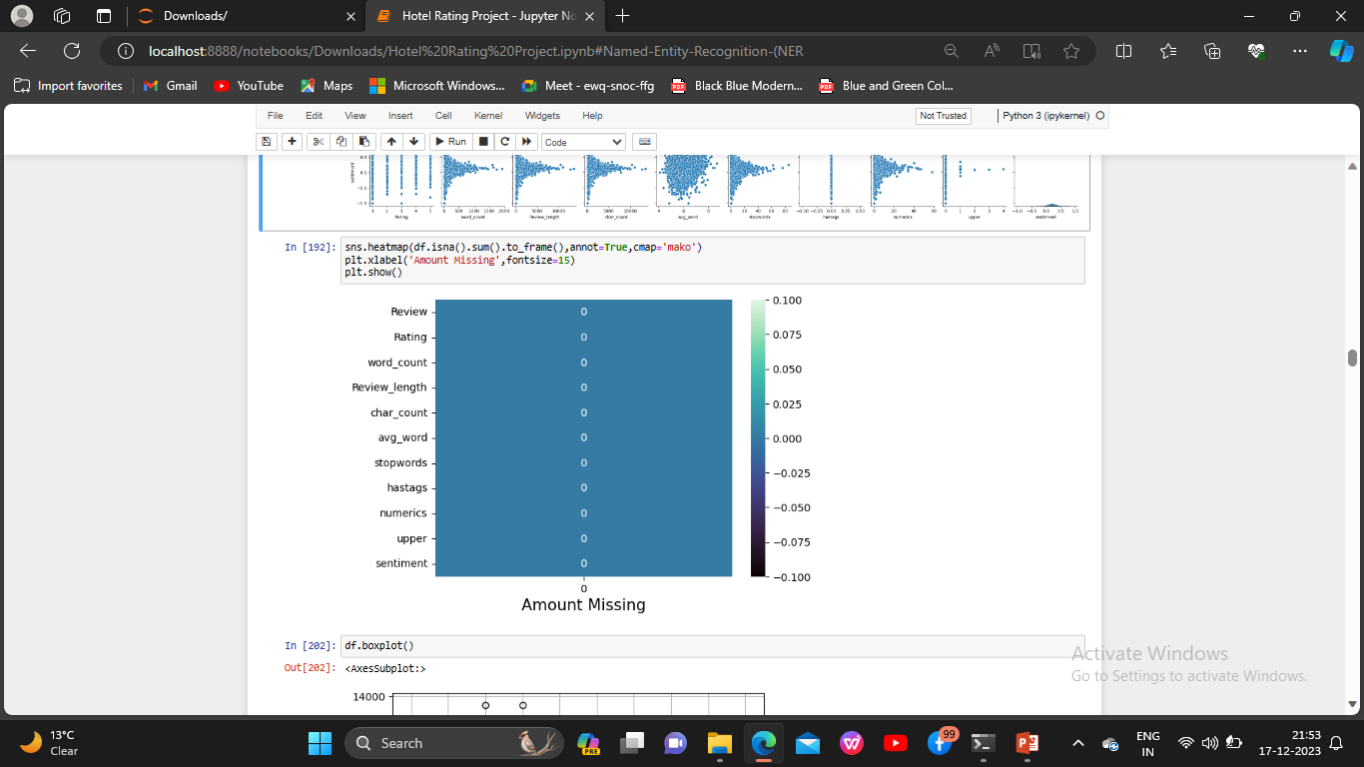

Slide 12
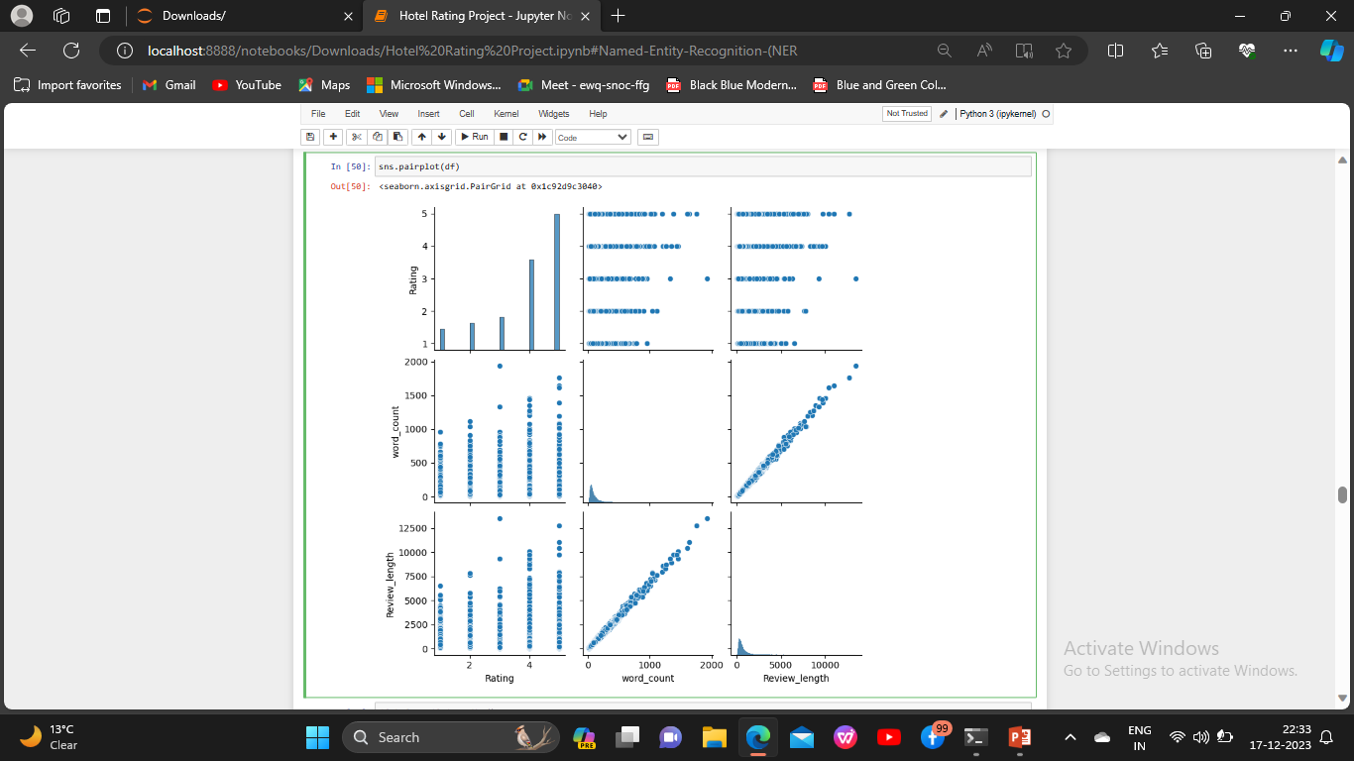

Slide 13
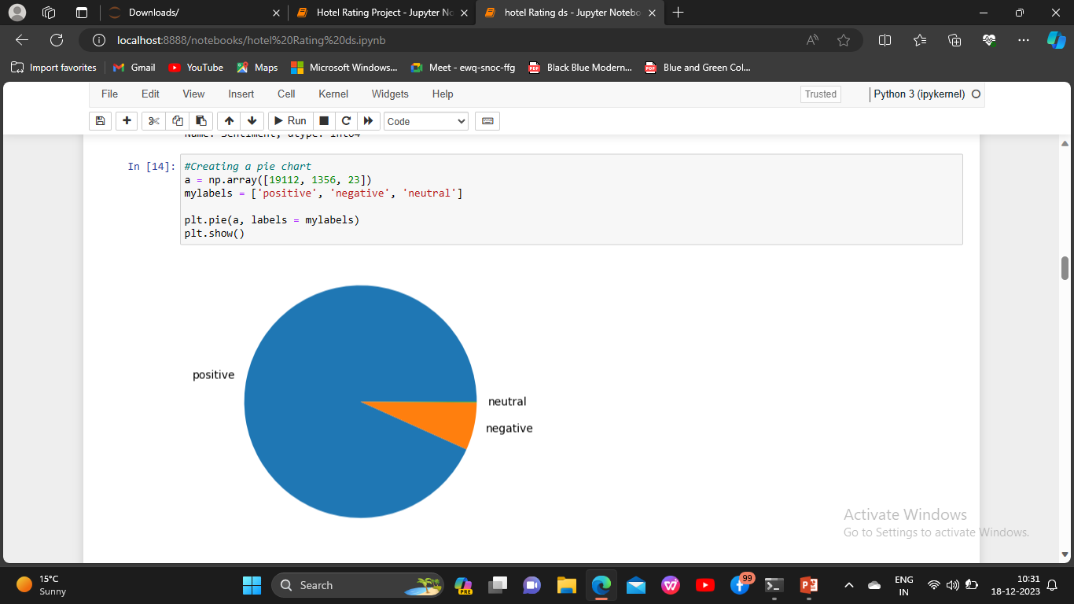
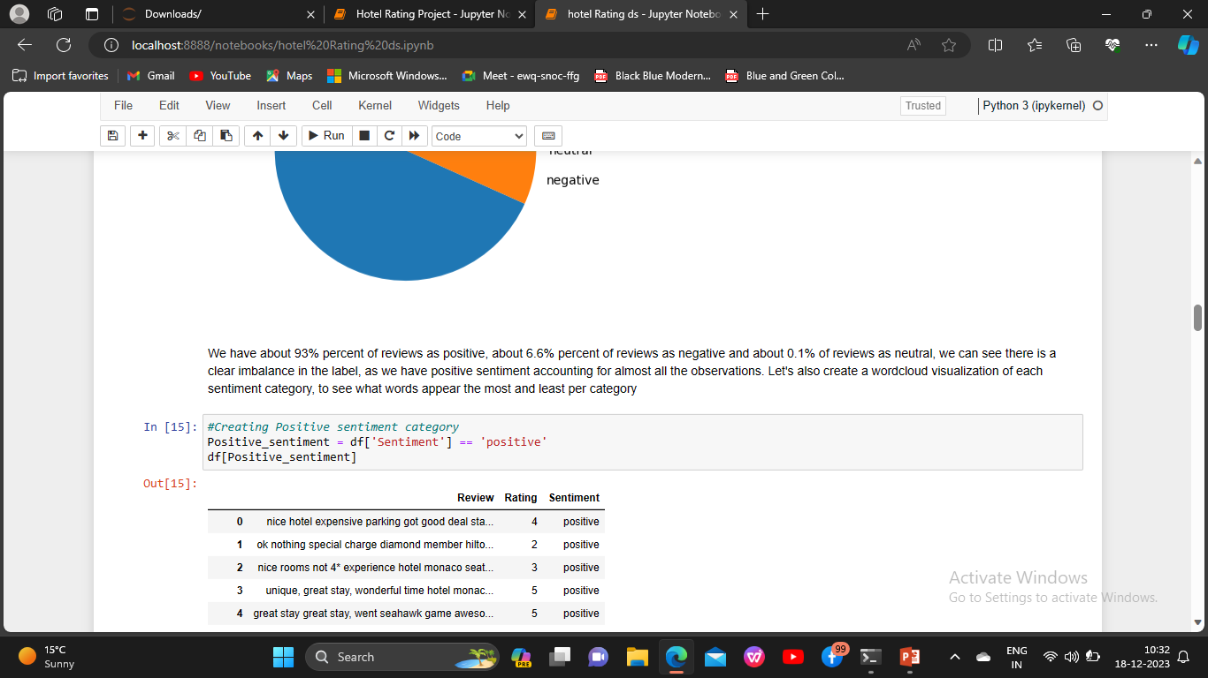

Slide 14
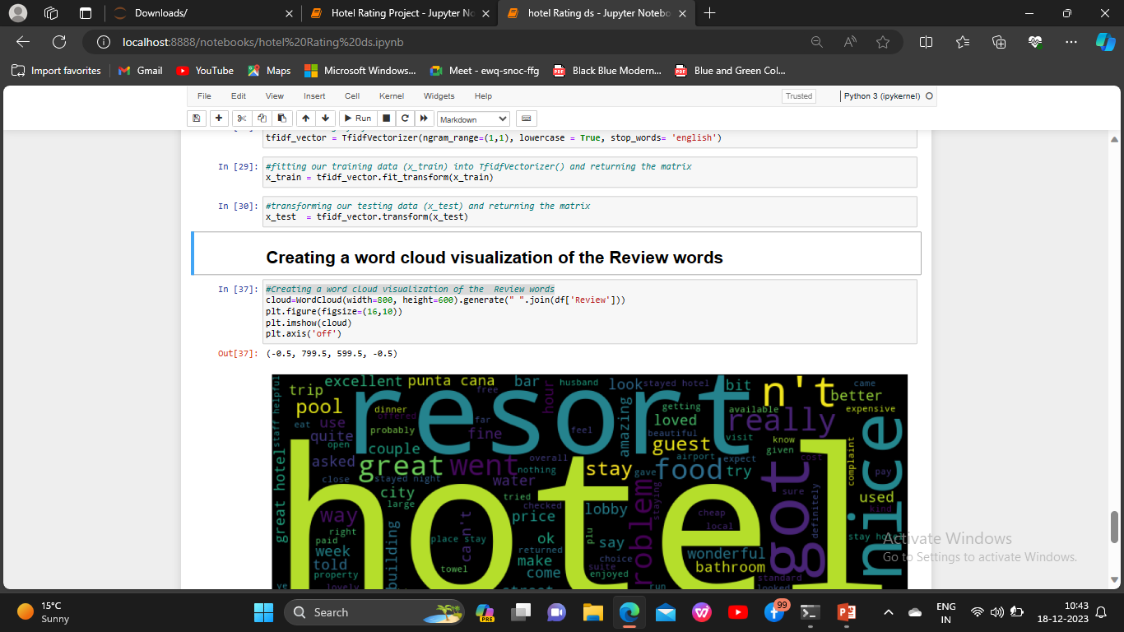
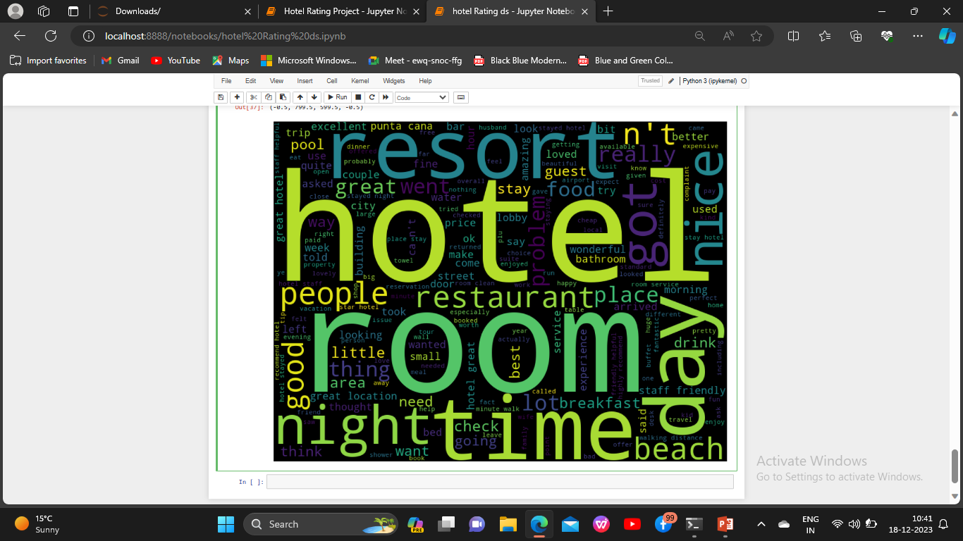

Slide 15
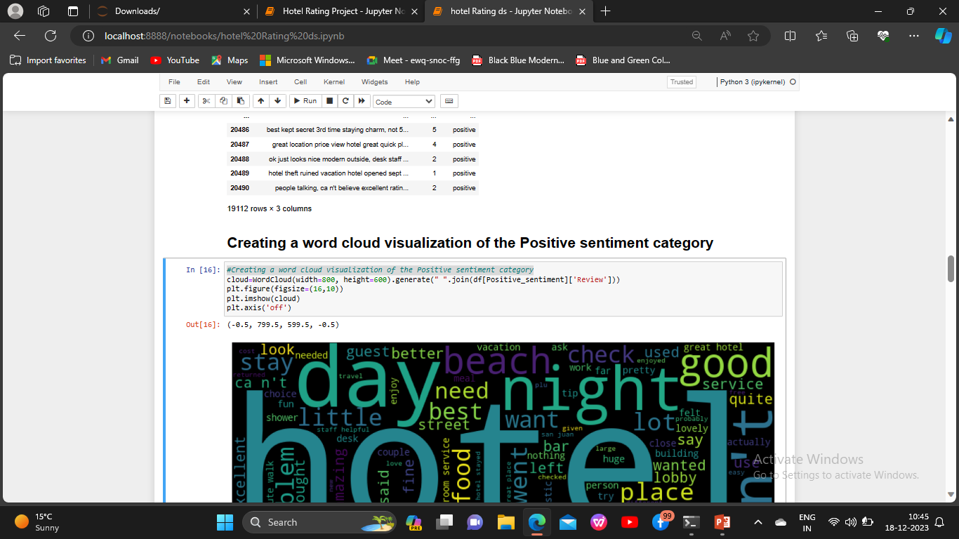
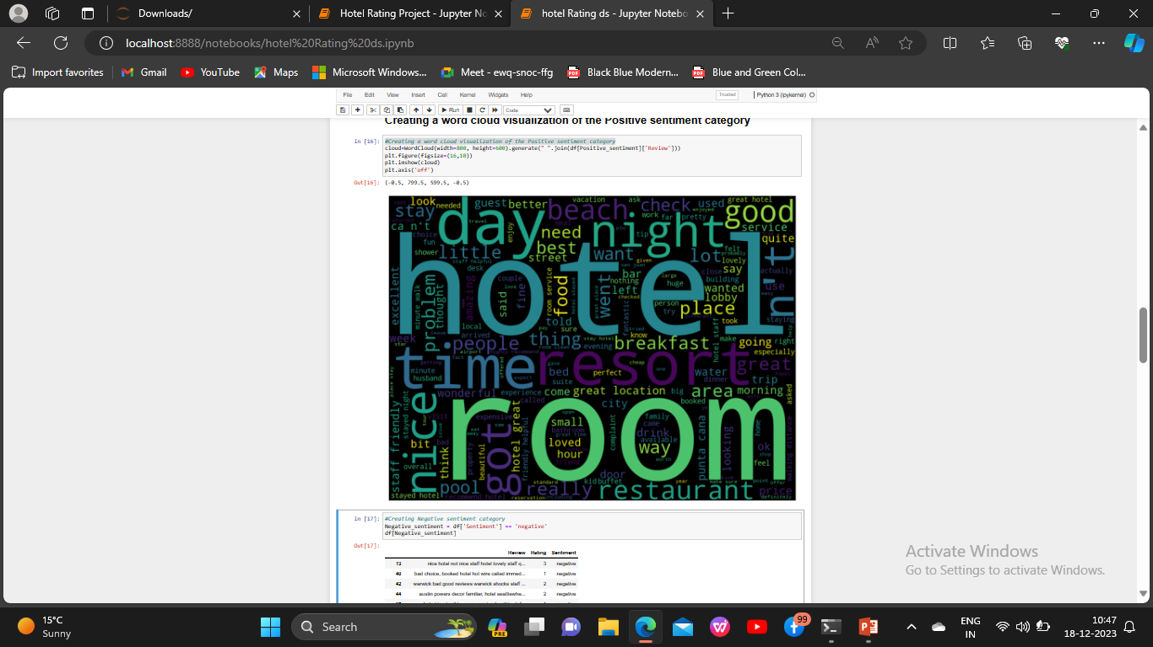

Slide 16
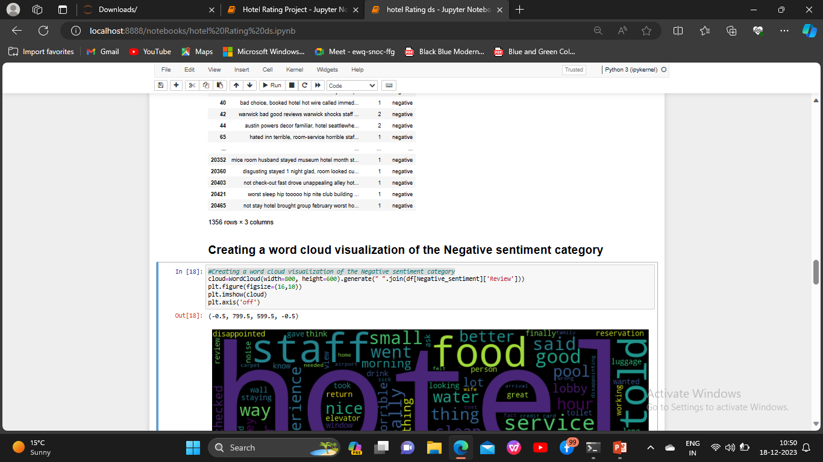
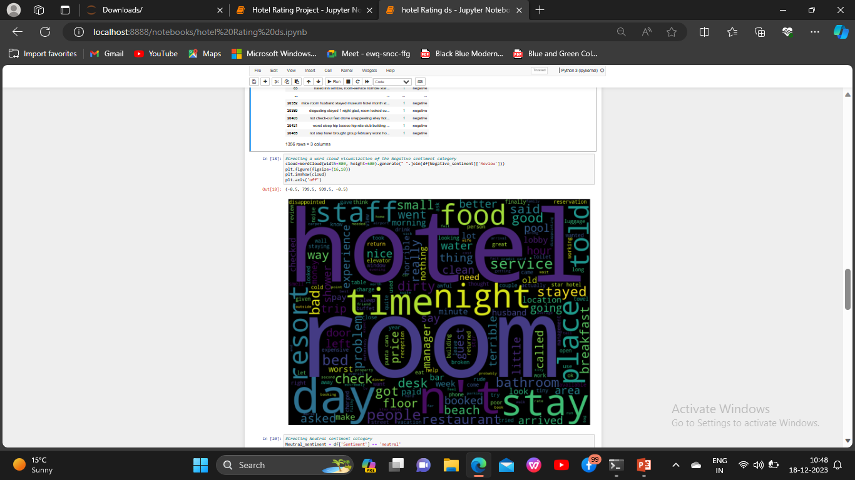

Slide 17
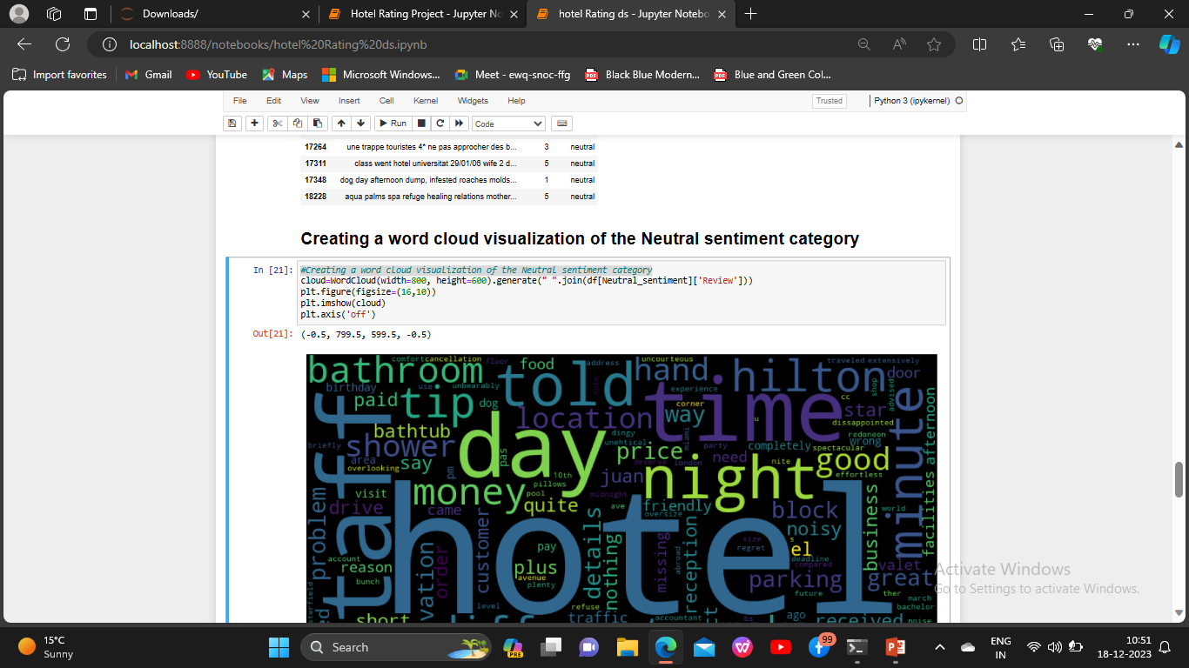
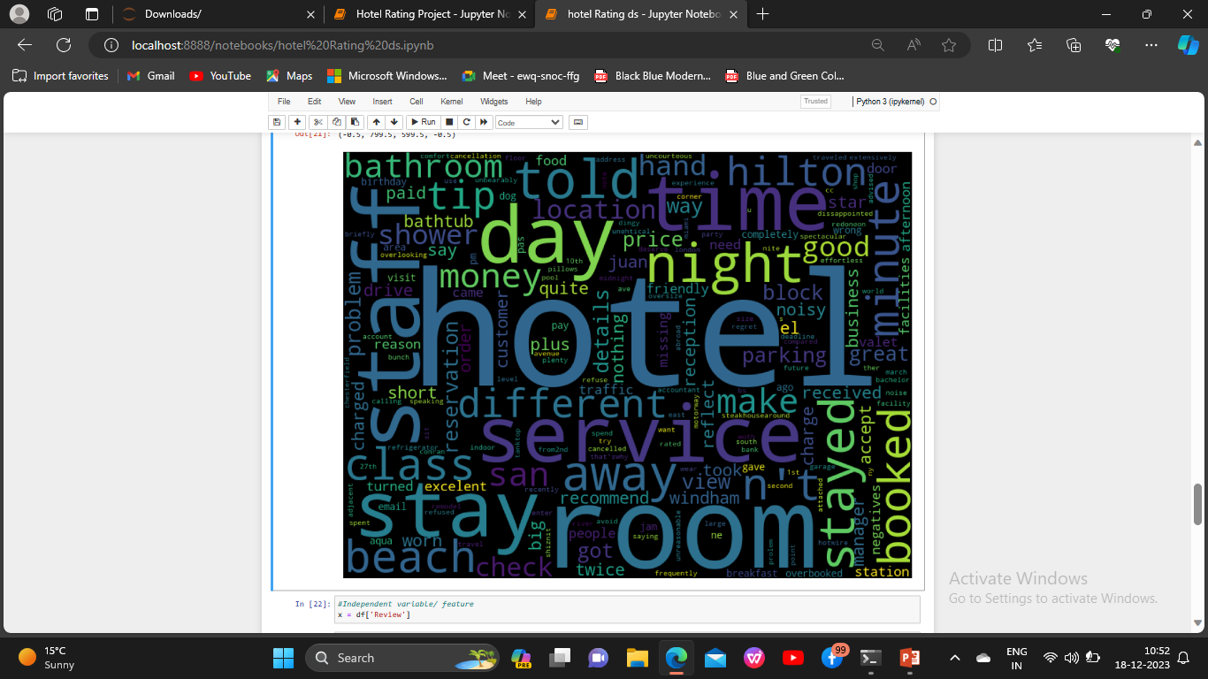

Slide 18
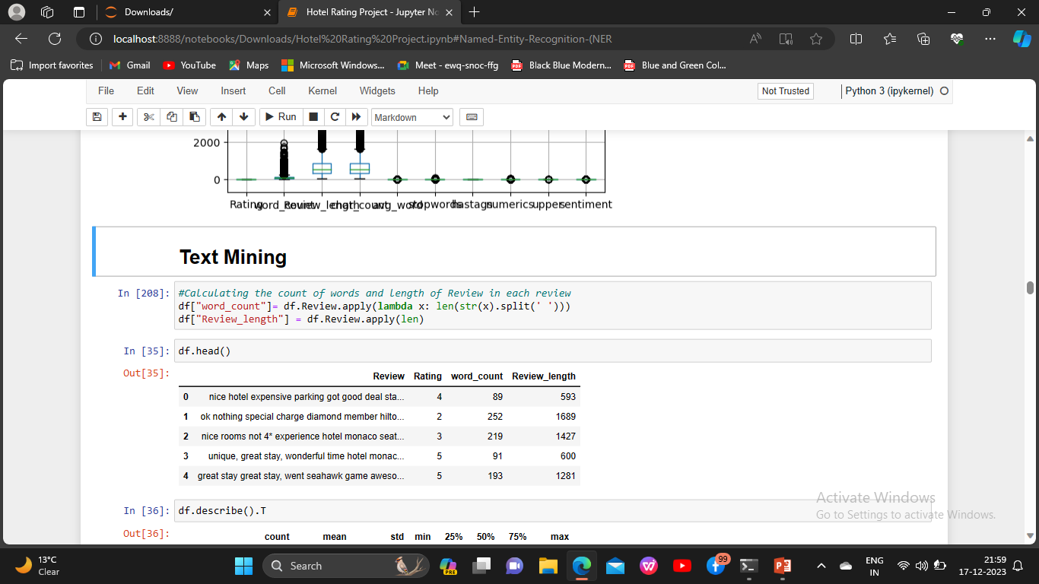
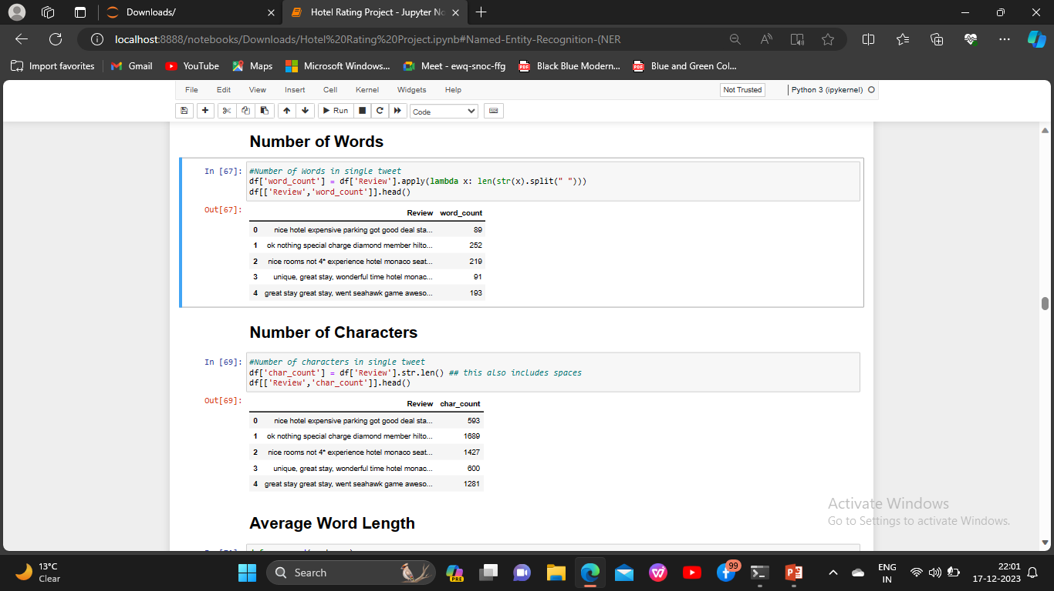
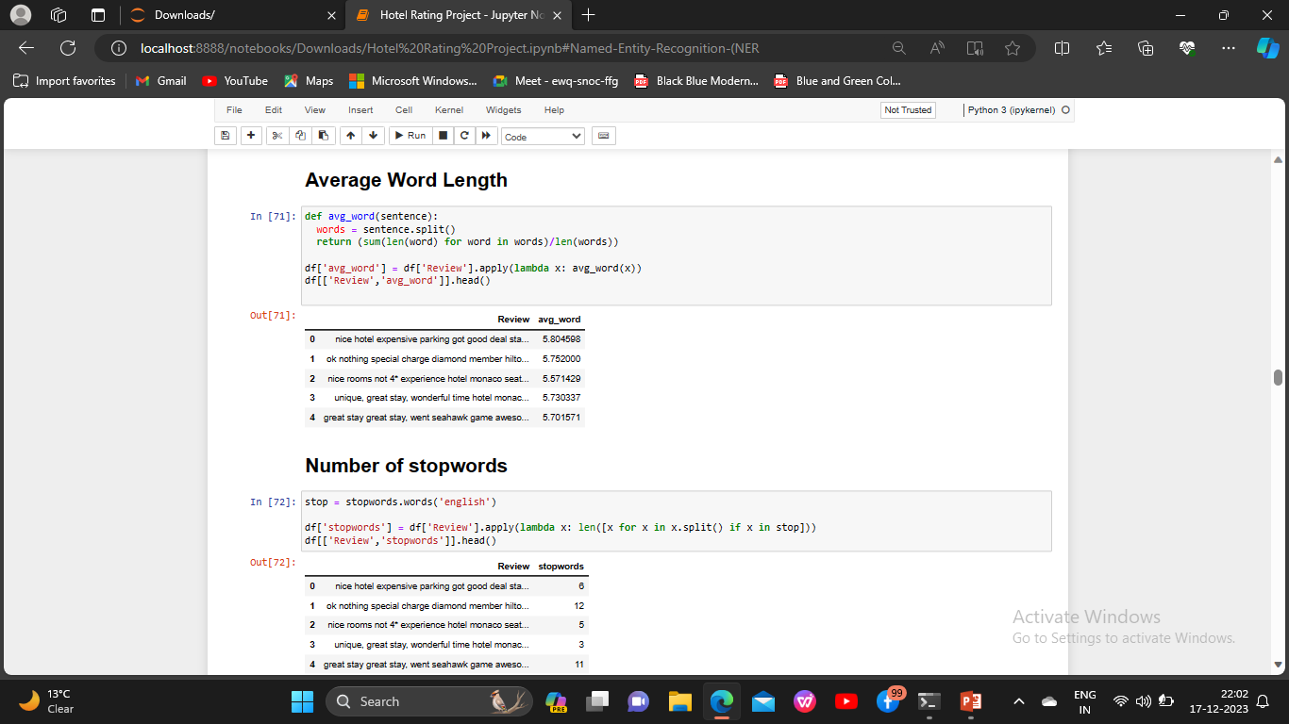

Slide 19
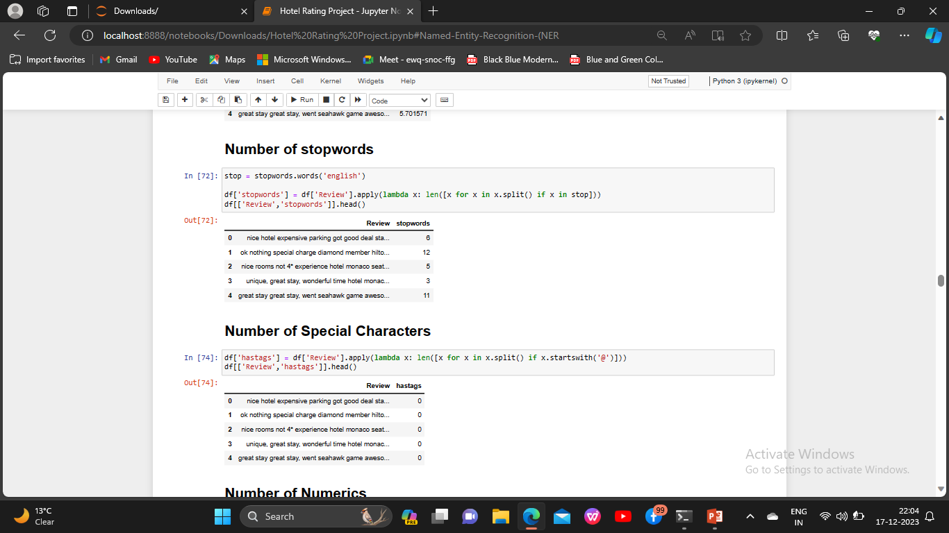
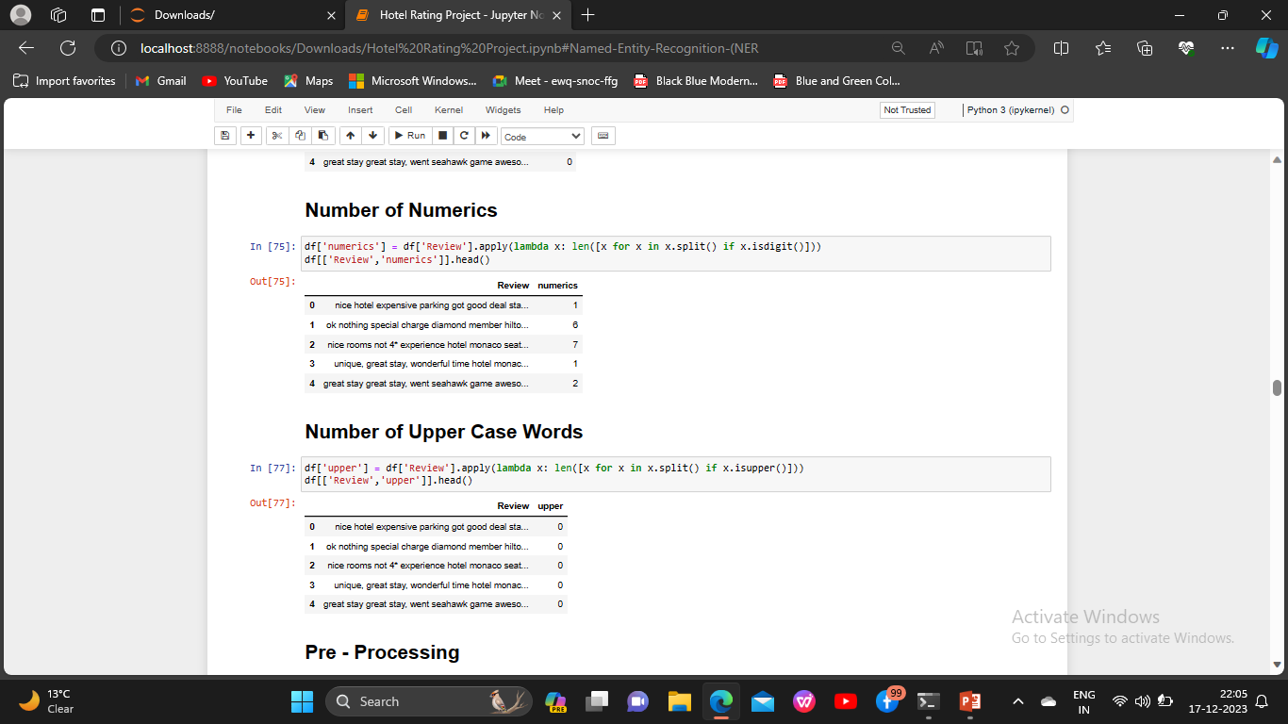

Slide 20
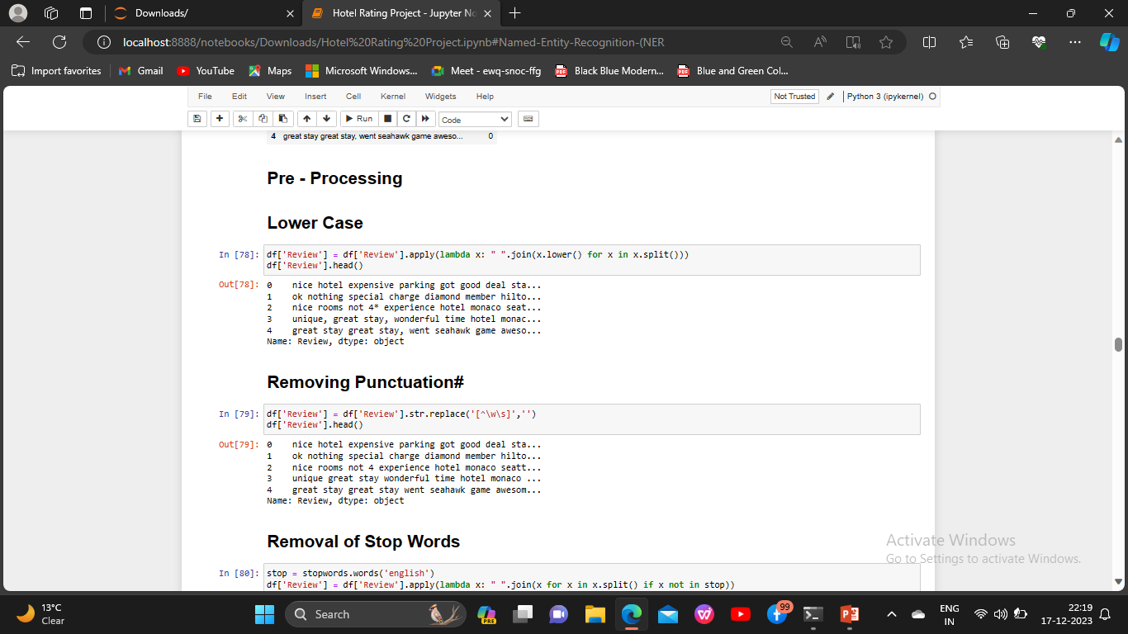
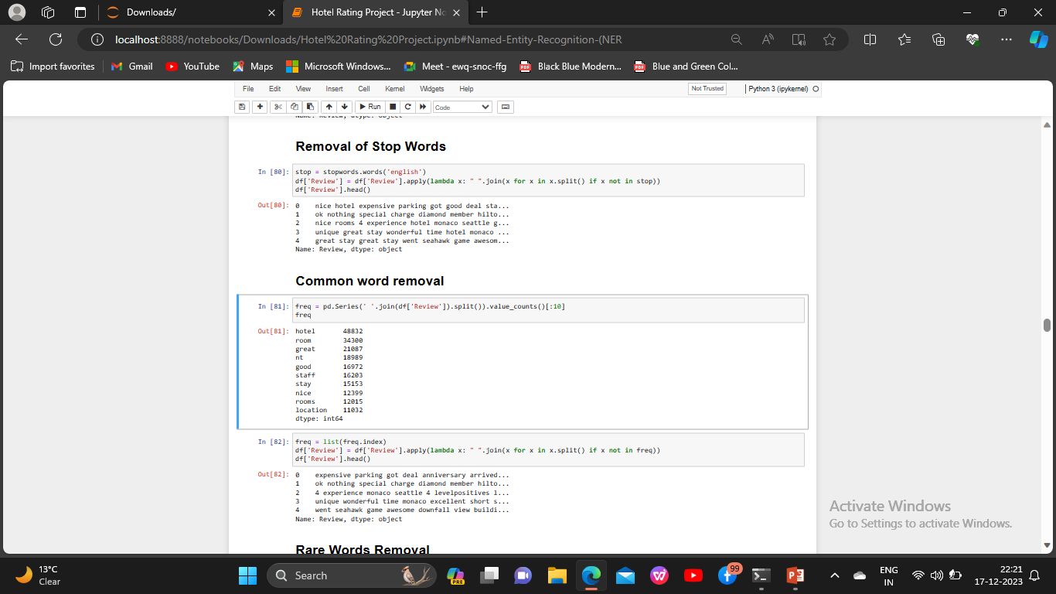

Slide 21
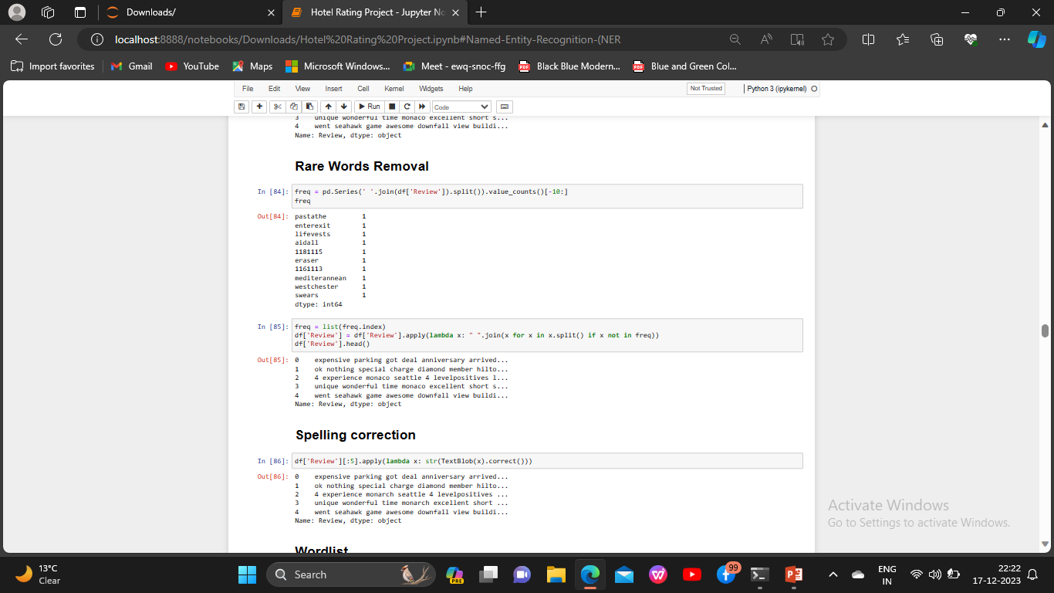
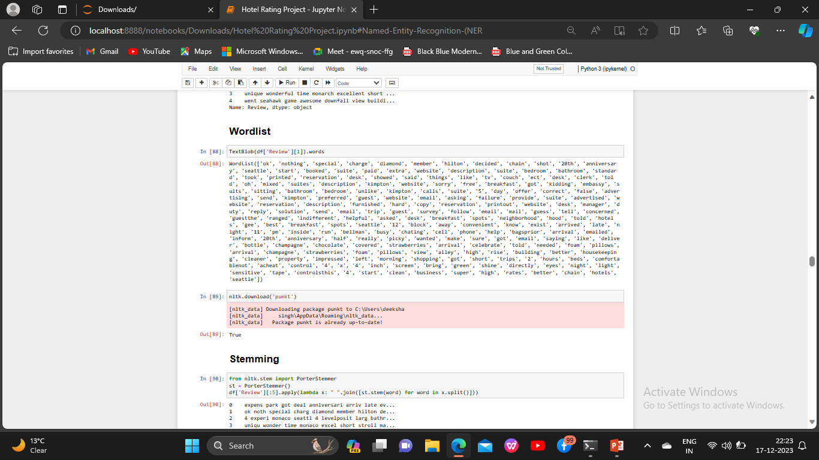

Slide 22
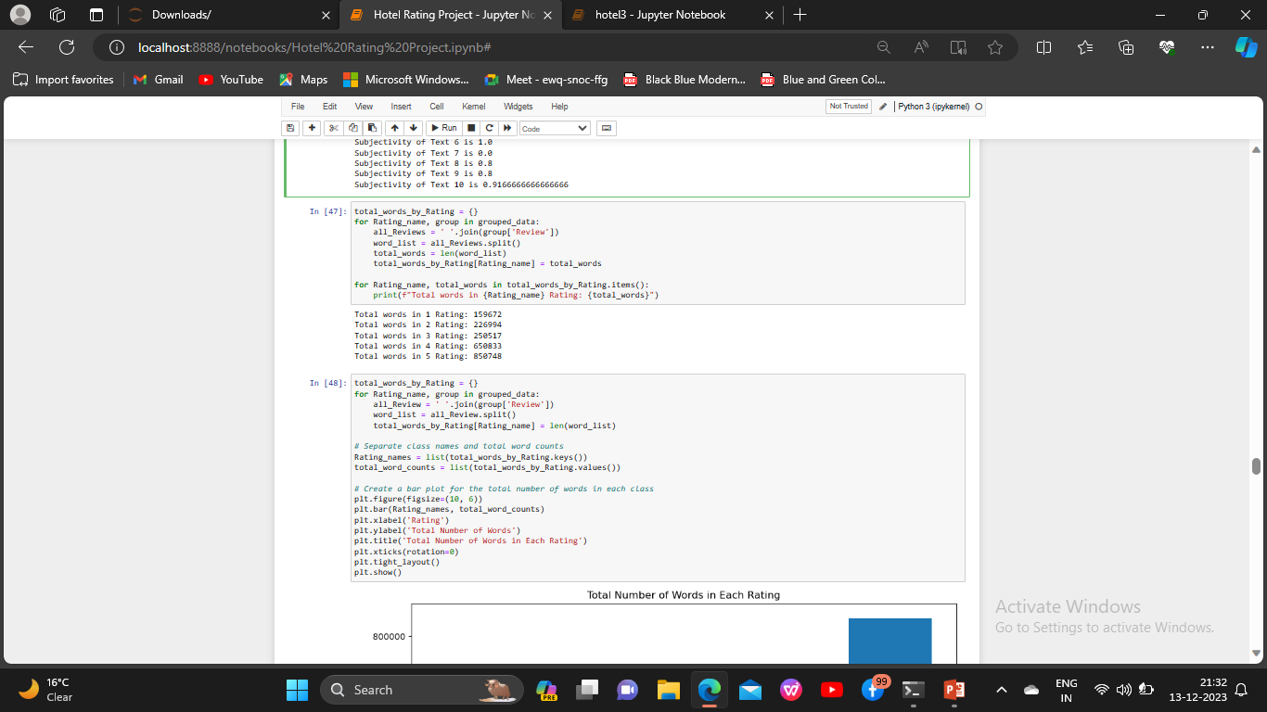
Total Words by Rating

Slide 23
Sentiment Analysis
Sentiment analysis is the process of analyzing digital text to determine if the emotional tone of the message is positive, negative, or neutral.

Slide 24
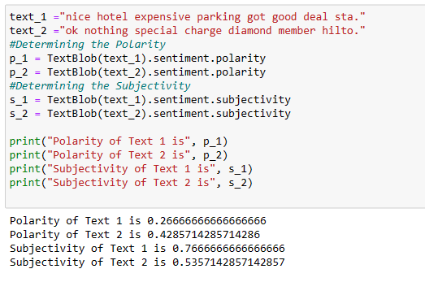
Using Text Blob
Text Blob is a Python library for Natural Language Processing. Using Text Blob for sentiment analysis is quite simple. It takes text as an input and can return polarity and subjectivity as outputs.

Slide 25
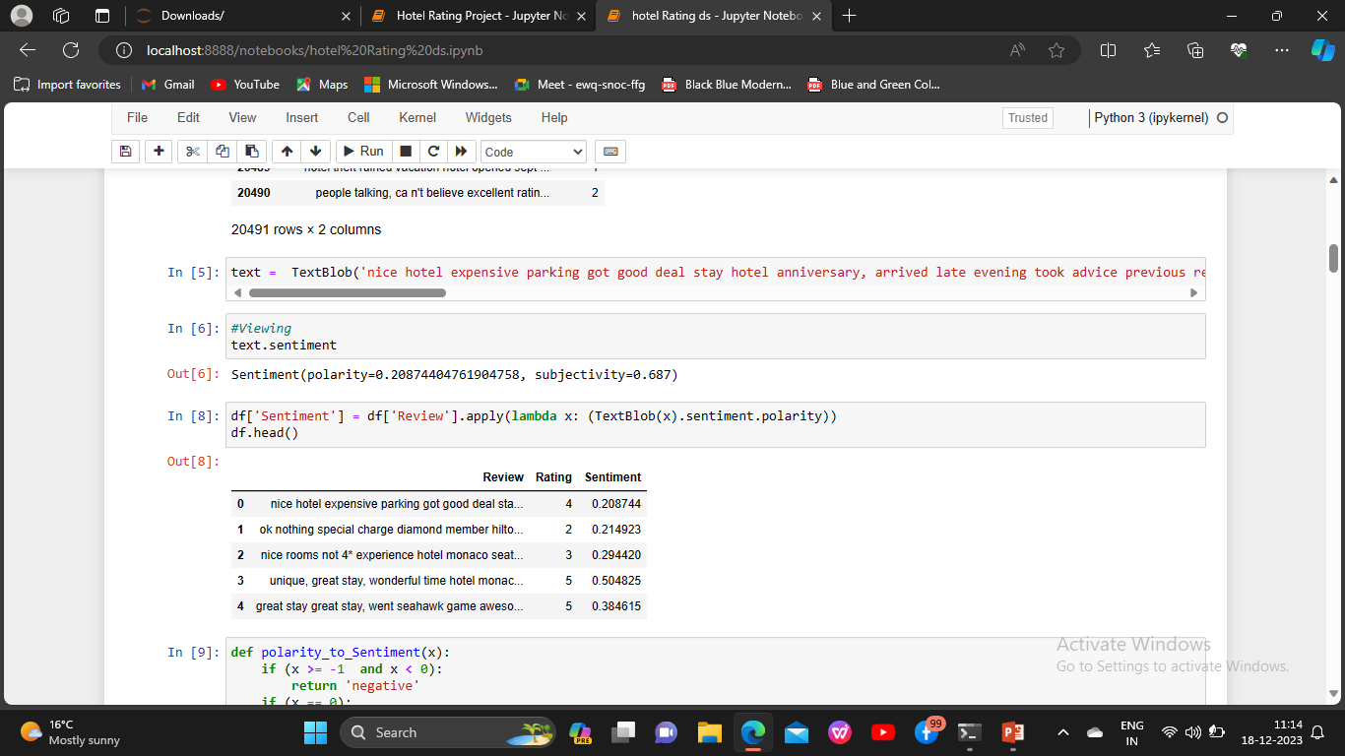
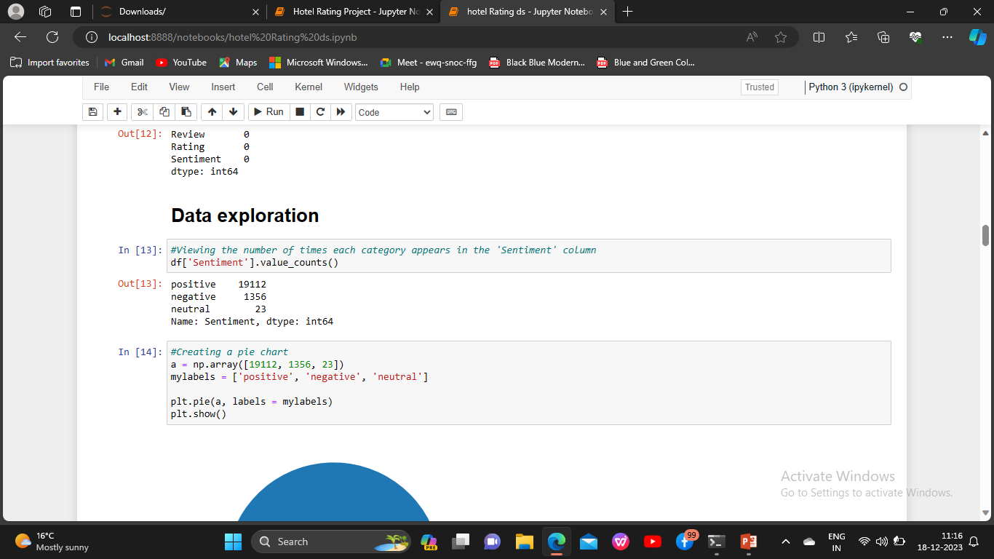

Slide 26
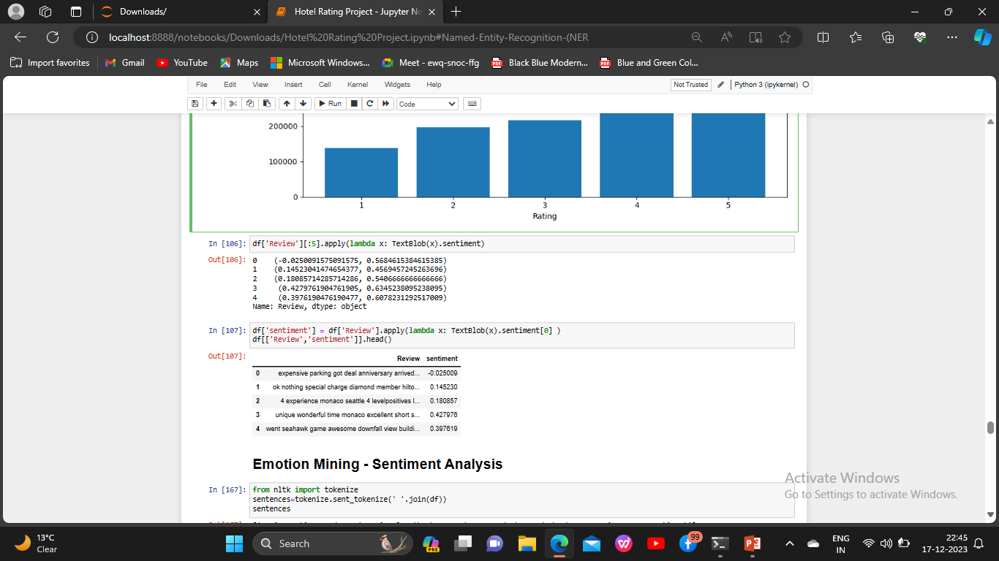

Slide 27
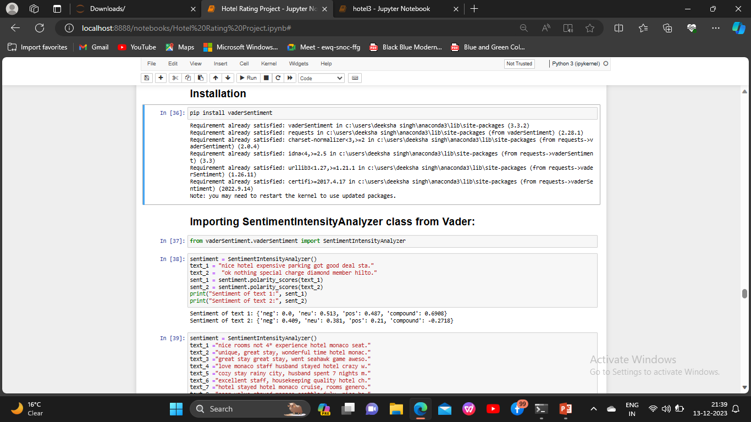
Using VADER

Slide 28
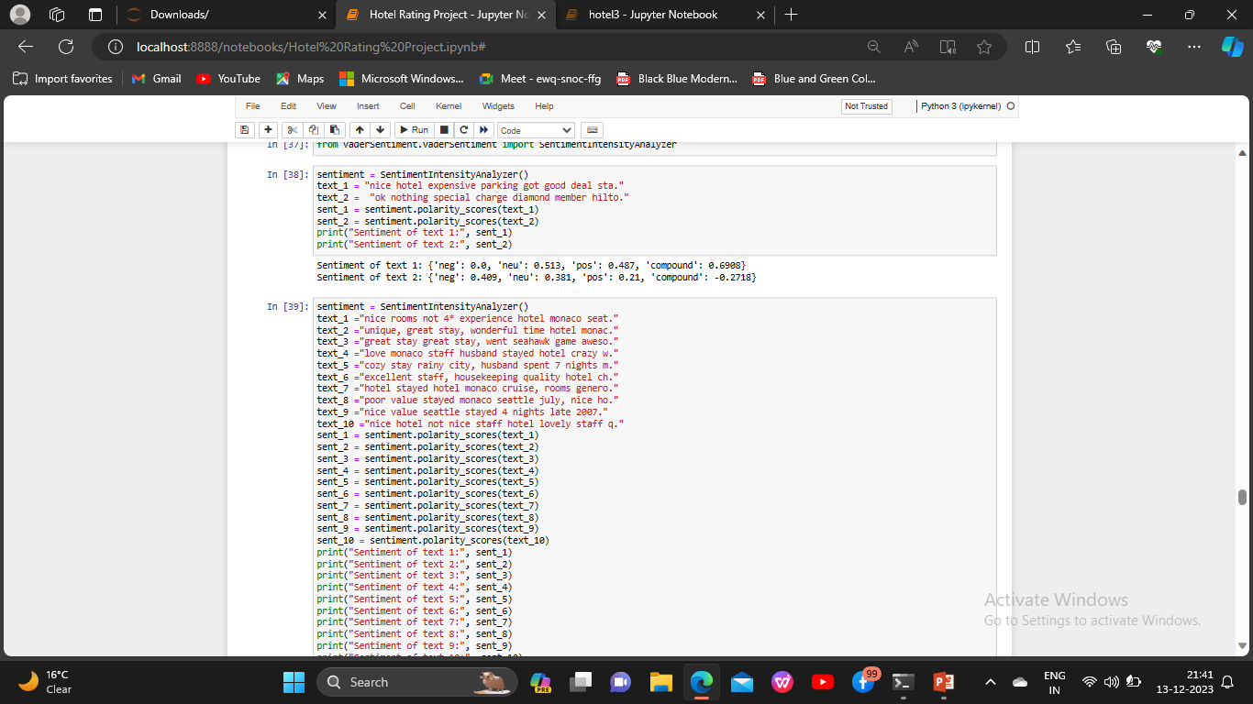
For 2 text

Slide 29
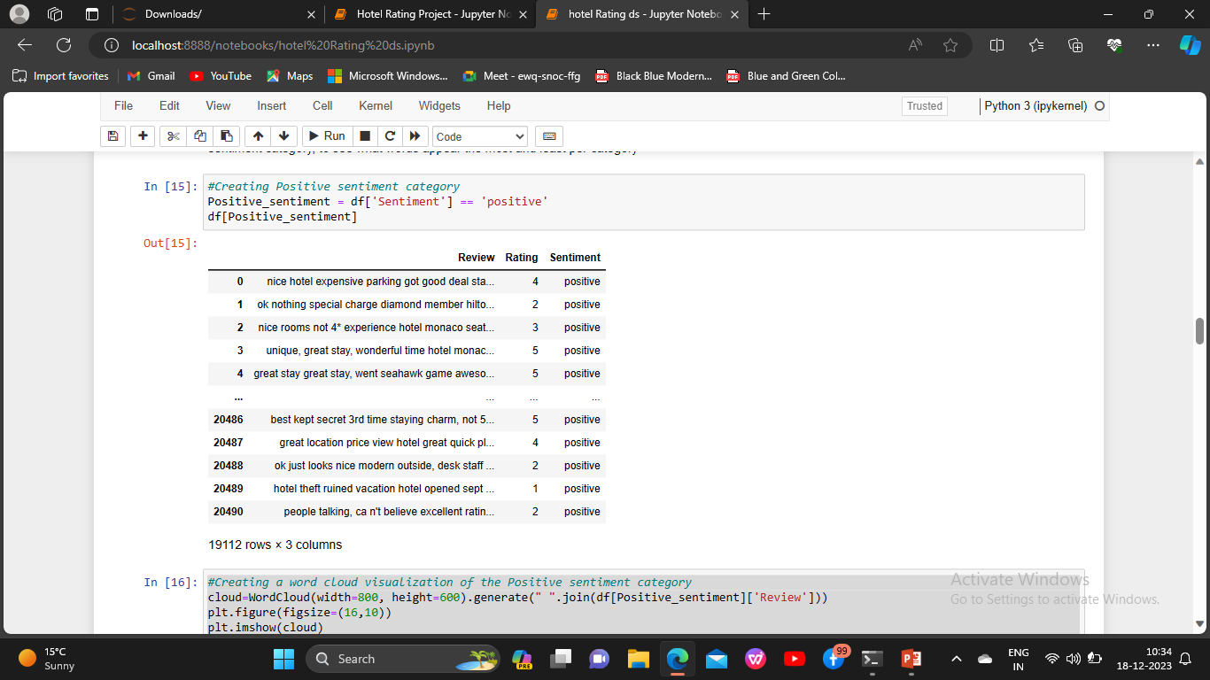
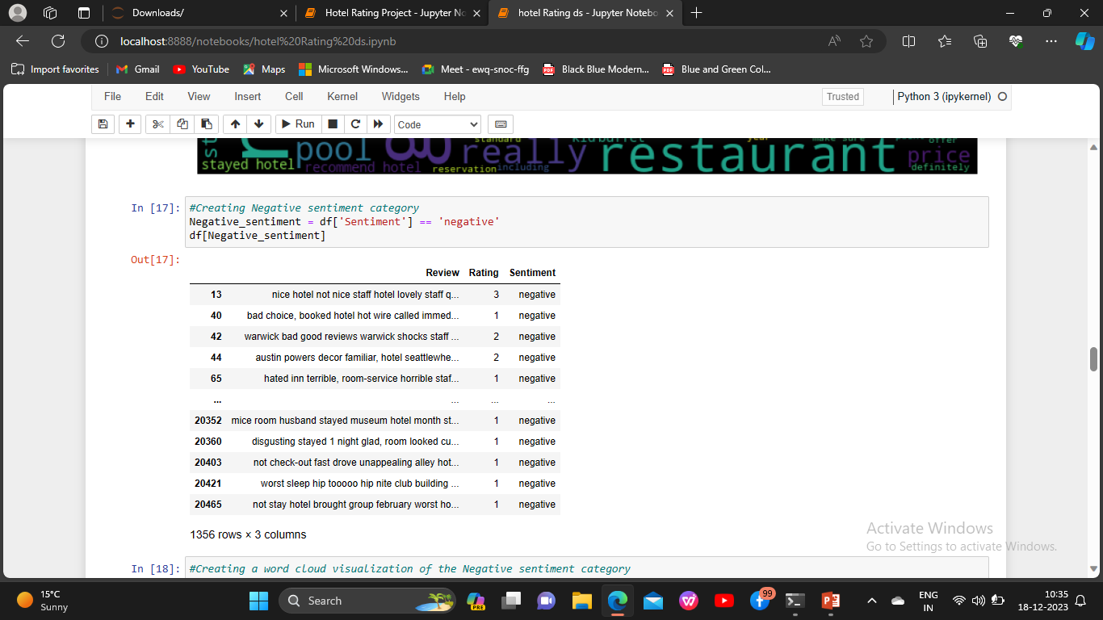

Slide 30
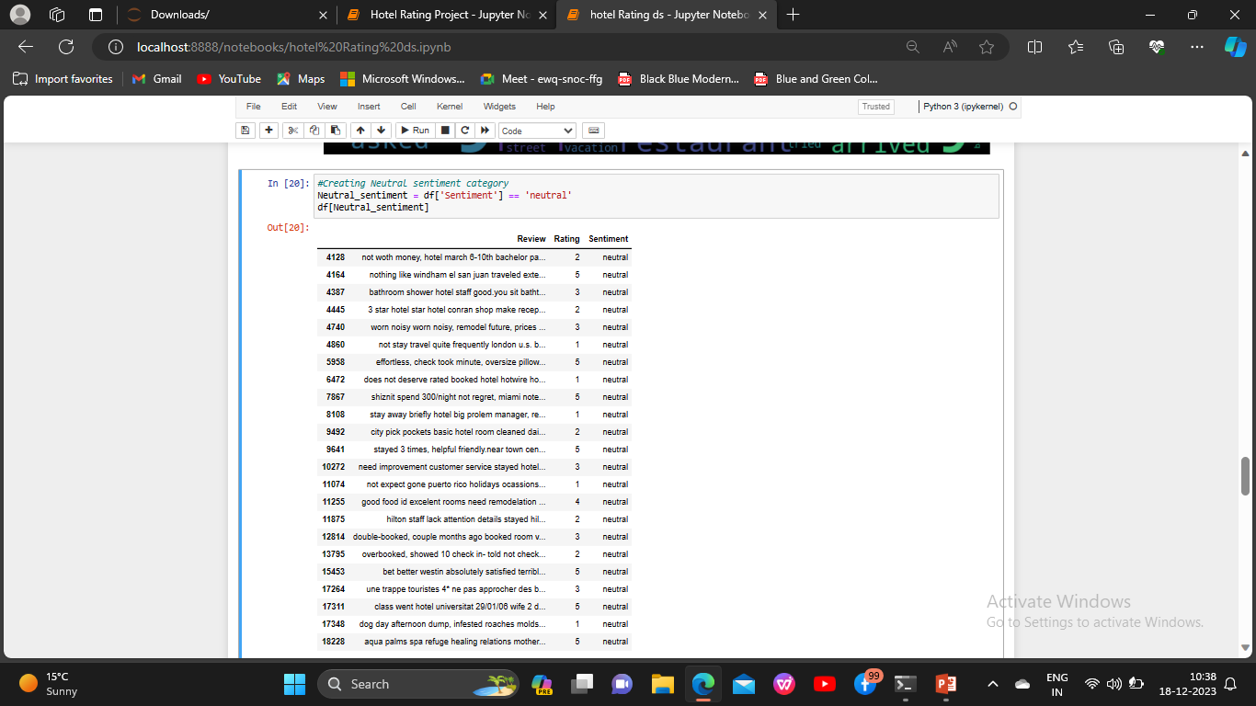

Slide 31
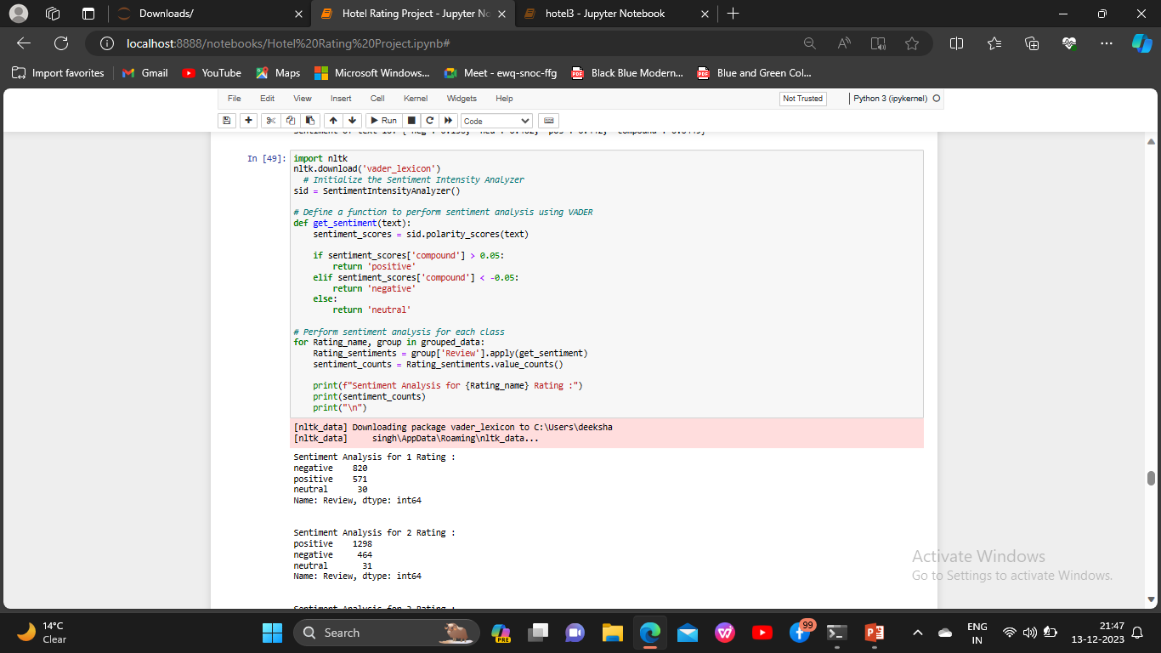
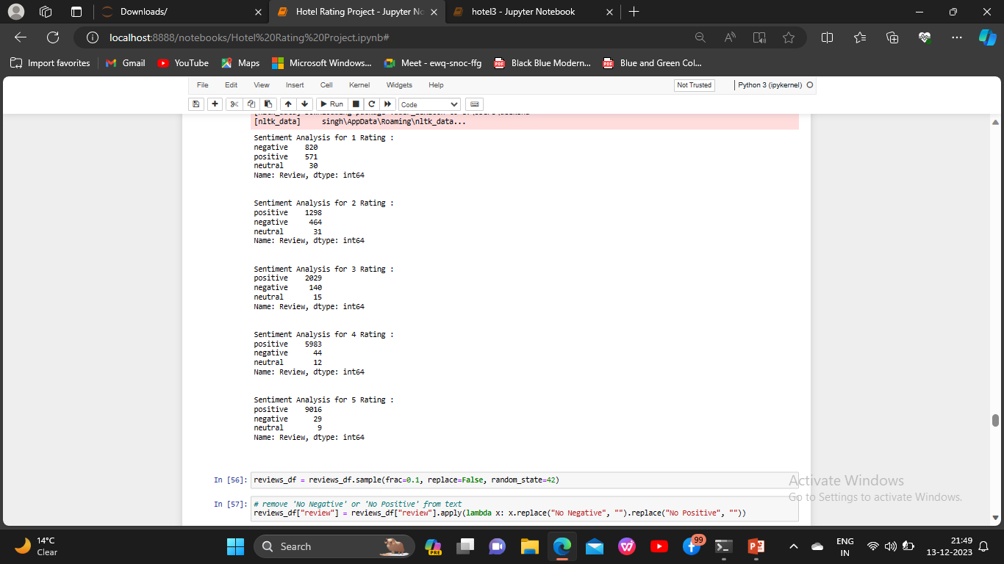
Using VADER Method for words

Slide 32
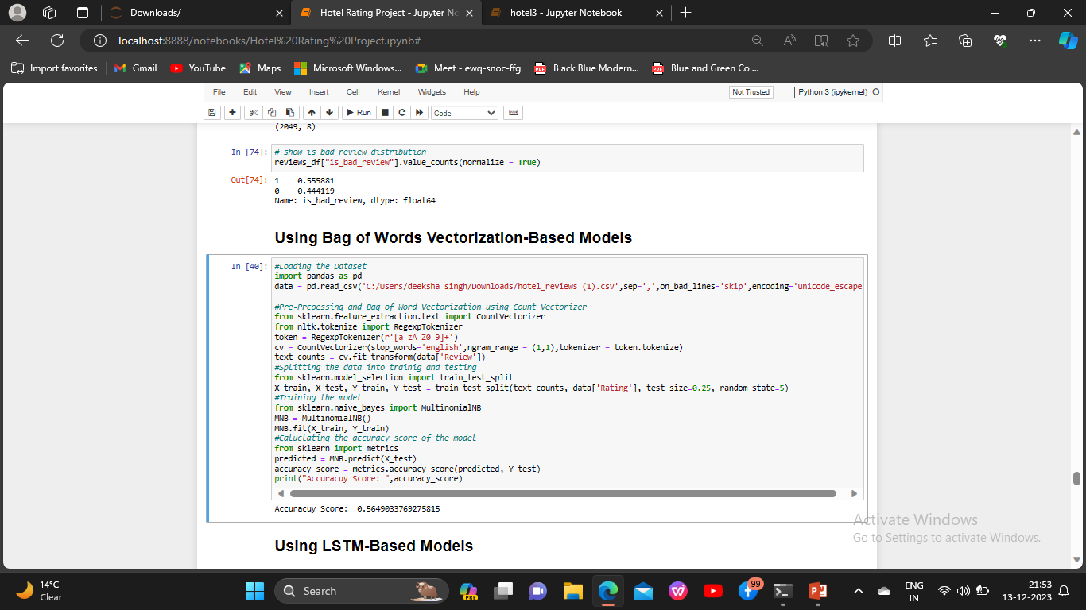
Using Bag of Words Vectorization-Based Models

Slide 33
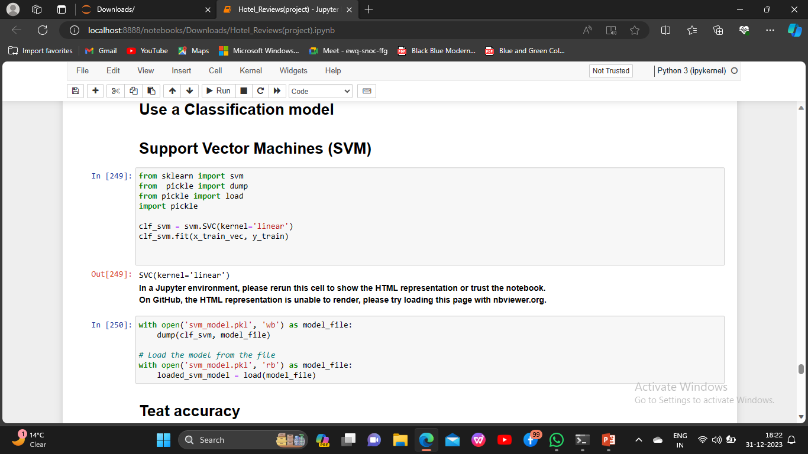

Model Building

Slide 34




Slide 35



Slide 36

plotting the accuracy and f1 score

Slide 37


Deployment

Slide 38
Problem faced during the project
DUE TO THE VAST AMOUNT OF THE DATA AND THE REVIEWS IT GETS DIFFICULT TO UNDERSTAND THE DATA .
ALL THE REVIEWS ARE UNIQUE.
CHOOSING THE APPROPRIATE MACHINE LEARNING MODEL WHICH WOULD BE MORE FEASIBLE FOR THE TASK IS CRITICAL .
MODELS HAVE DIFFERENT STRENGTHS AND WEAKNESSES, AND SELECTING THE WRONG ONE CAN LEADS TO A WRONG DECISSION.
RESULT IN SUBOPTIMAL PERFORMANCE.
UNDERSTANDING THE KEYWORDS.

Slide 39
OVERFITTING OCCURS WHEN THE MODEL PERFORMS WELL ON THE TRAINING DATA BUT POORLY
ON UNSEEN DATA. THIS CAN HAPPEN IF THE MODEL IS TOO COMPLEX OR IF THE TRAINING DATA IS
NOT REPRESENTATIVE OF THE TEST DATA.
DEPLOYING A MACHINE LEARNING MODEL TO A PRODUCTION ENVIRONMENT CAN BE COMPLEX.
INTEGRATION WITH EXISTING SYSTEMS, SCALABILITY, AND MAINTAINING THE MODEL’S
PERFORMANCE IN REAL-TIME ARE SOME OF THE CHALLENGES FACED DURING DEPLOYMENT.
IN SOME CASES, THE DEPLOYMENT ENVIRONMENT MAY HAVE HARDWARE LIMITATIONS, SUCH AS
LIMITED PROCESSING POWER OR MEMORY, WHICH CAN IMPACT THE CHOICE OF MODEL AND ITS
CONFIGURATION.

Slide 40
…THANK YOU…

